Slide 1
BRITISH EAST INDIA COMPANY PART-1
SEM-III, CC-VII
DEBABRATA NANDI

Slide 2
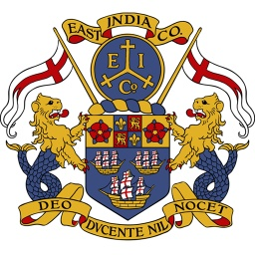
BRITISH EAST INDIA COMPANY

Slide 3
The East India Company (EIC) was an English, and later British, joint-stock company founded in 1600 and dissolved in 1874.It was formed to trade in the Indian Ocean region, initially with the East Indies (the Indian subcontinent and Southeast Asia), and later with East Asia.
East India Company, also called English East India Company, formally (1600–1708) Governor and Company of Merchants of London Trading into the East Indies or (1708–1873) United Company of Merchants of England Trading to the East Indies

Slide 4
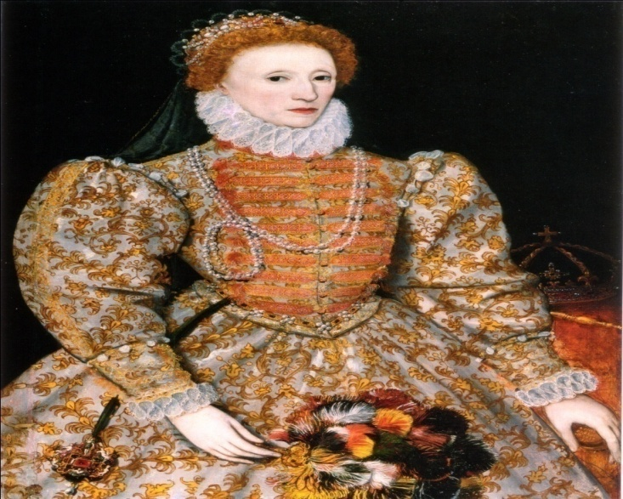
In 1600 queen Elizabeth granted a royal charter to a company named Eastern treading company.

Slide 5
*Sir James Lancaster commanded the first East India Company voyage in 1601 aboard the Red Dragon

Slide 6
English traders frequently engaged in hostilities with their Dutch and Portuguese counterparts in the Indian Ocean. The company achieved a major victory over the Portuguese in the Battle of Swally in 1612, at Suvali in Surat. The company decided to explore the feasibility of gaining a territorial foothold in mainland India, with official sanction from both Britain and the Mughal Empire, and requested that the Crown launch a diplomatic mission.

Slide 7
*In 1605 AKBAR granted there request for tread in India .
*So in 1608 Captain Howkyns came to jahangirs court but he did not permit them . In 1613 they were permitted at surat for the first time. 1615 sir Tomas Roe came to his court .
*IN 1611 they establish their pert at Mossulupattanam in coromondal coast .

Slide 8
In 1632 they captured Hugli port.
After they also captured kasimbazar, patna ETC.
In 1639 they established a settlement at madras. And built ‘SENT GURZE FORT ”there.
In 1661 they get Bombay as a gift from portugal .
In 1690 job Charnoc founded the city of Calcutta.

Slide 9
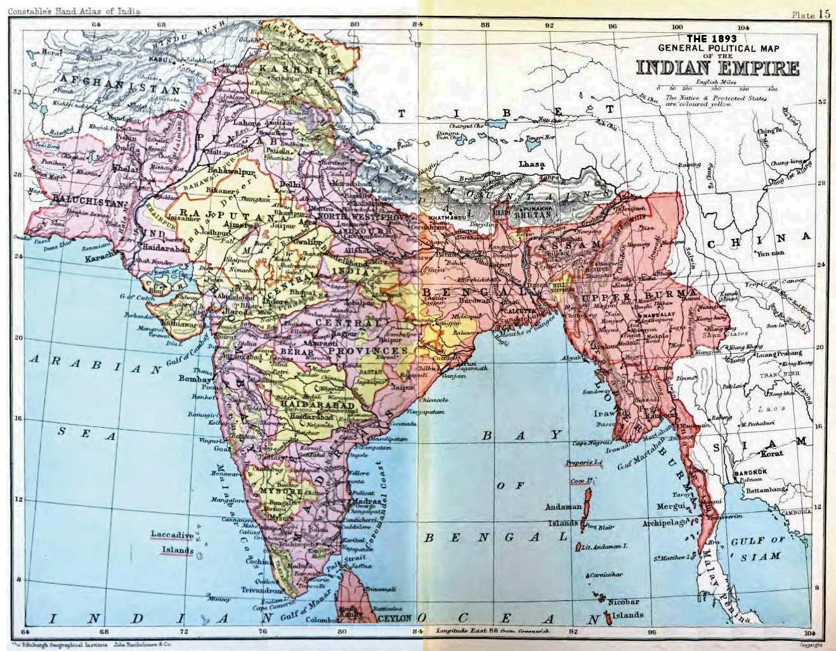

Slide 10
The company eventually came to rule large areas of India, exercising military power and assuming administrative functions. Company rule in India effectively began in 1757 after the Battle of Plassey and lasted until 1858 when, following the Indian Rebellion of 1857, the Government of India Act 1858 led to the British Crown assuming direct control of India in the form of the new British Raj.

Slide 11
THANK YOU

